Slide 1
Geometric Transformations
Li Guiqing
South China University of Technology

Slide 2
Agenda
2D geometric transformations (二维几何变换)
3rd: chap 5;4th: chap 7
3D geometric transformations (三维几何变换)
3rd: chap 7; 4th: chap 9
Mathematical
representation?

Slide 3
Agenda
2D geometric transformations (二维几何变换)
Homogeneous coordinates (齐次坐标表示)
Basic transformations (基本变换)
Composite transformations (复合变换)
三维变换
裁剪

Slide 4
2D geometric transformations
Transform 2D objects from world coordinates to screen coordinates
(从世界坐标到屏幕坐标)
Applications: vector graph, cartoon animation (矢量图形、卡通动画)
Common used transformations
基本变换：平移、旋转、放缩
其它变换：剪切、对称、复合

Slide 5
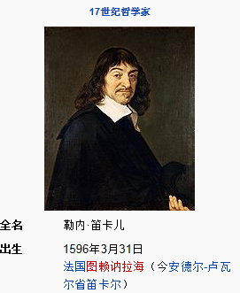
René Decartes
拉丁名:Renatus Cartesius
Descartes coordinates又称Cartesian coordinates
从逻辑、几何和代数发现4条规则：
绝不承认任何事物为真，对于我完全不怀疑的事物才视为真理；
将问题分成若干个简单部分来处理；
思想必须从简单到复杂；
时常进行彻底的检查，确保没有遗漏任何东西。

Slide 6
Homogeneous coordinates(齐次坐标)
Use an (n+1)-dimensional vector to represent an n-dimensional vector (n+1维向量表示n维点)
2D point (x, y) can be written as homogeneous coord. (X,Y,ω), where
x = X/ ω, y = Y/ ω
ω
P
2D point (2, 3) ➔ HC (4, 6, 2)
➔(3, 4.5, 1.5)
3D HC coord. (2,3,1)➔ HC(0.2, 0.3, 0.1,0.1)
➔ HC(20,30,10,10)
X
ω=1 平面
Y

Slide 7
Homogeneous coordinates
A space point can have infinite coordinate vectors as (有无穷多齐次坐标)
x=X/ω y=Y/ω
Advantages of HC(齐次坐标)
Support unified matrix representation
(矩阵变换的统一表示)
Infinity(可表示无穷大)
Prevent float overflow
(防止浮点数溢出)
ω
P
X
ω=1 平面
Y

Slide 8
2D Translation(二维平移)
Translating P(x,y) by (t_{x},t_{y}) leads to P'(x', y')
(x',y')
Y
Use HC(齐次坐标): (x, y) → (x, y, 1)
(x,y)
O
X

Slide 9
2D Rotation (二维旋转)
Rotate P(x, y) counterclockwise surrounding the origin(绕坐标原点按逆时针旋转角θ)
Y
Transformation formula:
(x',y')
(x,y)
θ
X

Slide 10
Scale (二维放缩)
All coordinates are scaled by a factor
Y
(x',y')
(x,y)
O
X
其中s_{x}和s_{y}分别为x和y分量的放缩比例

Slide 11
Shear (剪切变换或错切变换)
Shear a point along X-axis (沿x轴方向错切)
Y
(x, y)
(x', y')
α
X
y remains unchanged, x changes linearly;
Line segments parallel to x-axis are still parallel to x-axis after transformation (平行于x轴的线段错切后仍平行于x轴)
Line segments are still transformed to line segments (线段➔线段)

Slide 12
Symmetry (对称变换)
Y
(-x,y)
(x,y)
O
X
(-x,-y)
(x,-y)
关于X轴的对称变换
关于坐标原点的对称变换
关于Y轴的对称变换

Slide 13
Symmetry(continued)
Y
Y
(x,y)
y=x
(x,y)
O
O
X
X
(-y,-x)
y=-x
(y,x)
关于直线y=x的对称变换
关于直线y=-x的对称变换

Slide 14
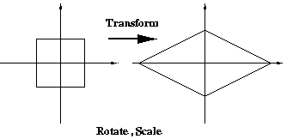
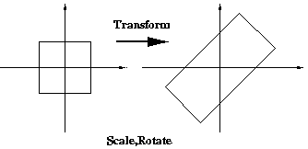
Composite transformation (复合二维变换)
A complex transform. is composed of translat., rotat. and scale transforms.
Associative law(结合): (AB)C=A(BC);
No commutative law(交换): AB≠BA
先旋转45，x方向放缩2
先(非等比例)放缩，再旋转

Slide 15
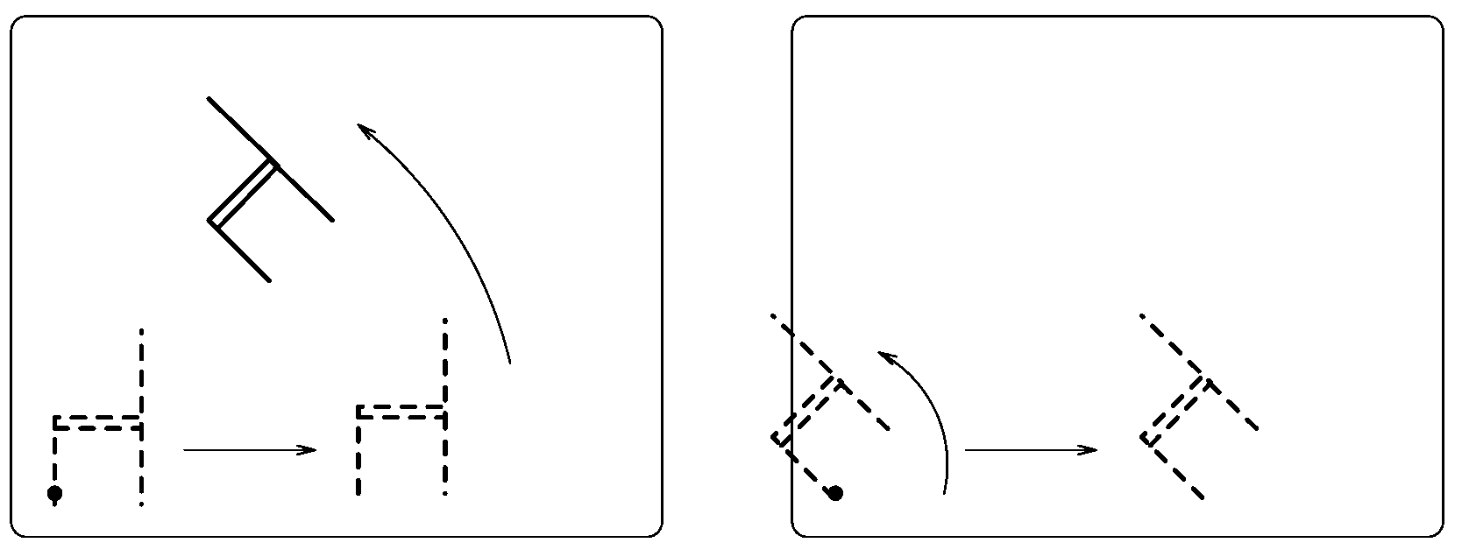
(continued)
Commutative law is not satisfied
先平移，再旋转
先旋转，再平移

Slide 16
(continued)
Rigid transformation(刚体变换)
The shape of the object is unchanged but the position and orientation may change (形状不变但位置与朝向变化)
The composition of translation and rotation transformations is rigid
刚体变换

Slide 17
(continued)
Affine transformation (仿射变换)
Preserve collinear, ratio of length, parallel (保持共线、长度比例、平行)
Is the composition of translation, rotation and scale (由旋转、平移、缩放复合得到)
仿射变换

Slide 18
Generalization(一些一般情形)
绕点(x0, y0)旋转θ角的变换
关于ax+by+c=0的对称变换
点(x0, y0)保持不变的缩放变换
……

Slide 19
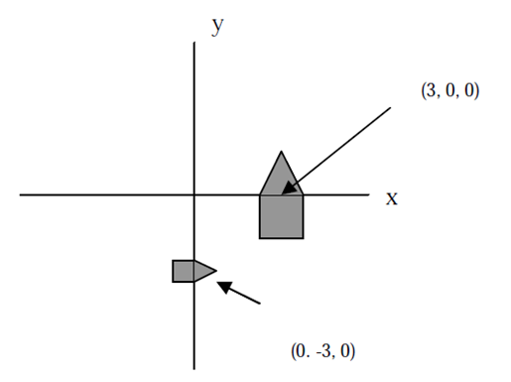
Example (例子)
建立A变到B的换矩阵 ：B比A放大了一倍
(3,0)
B
A
(0, -3)

Slide 20
Agenda
二维变换
三维变换(3D geometric transformation)
场景坐标系和造型变换
视点坐标系和取景变换
投影坐标系和投影变换
屏幕坐标系和设备变换
裁剪

Slide 21
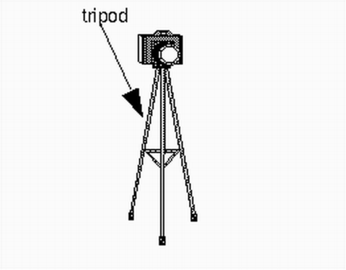
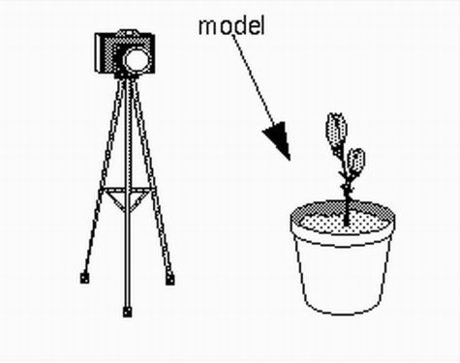
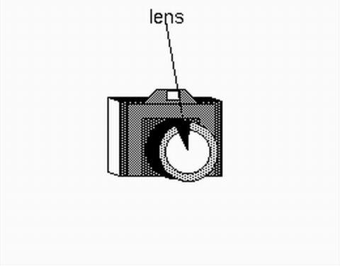
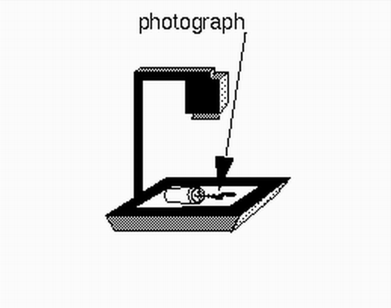
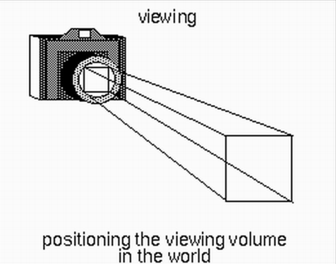
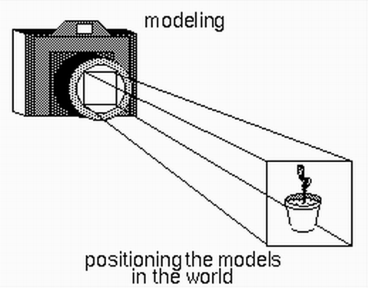
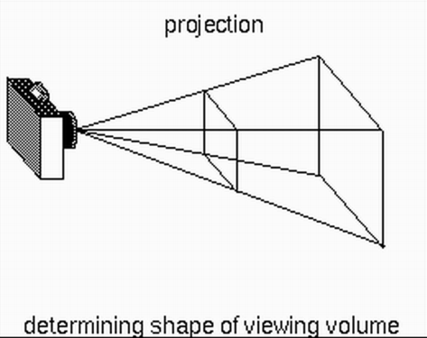
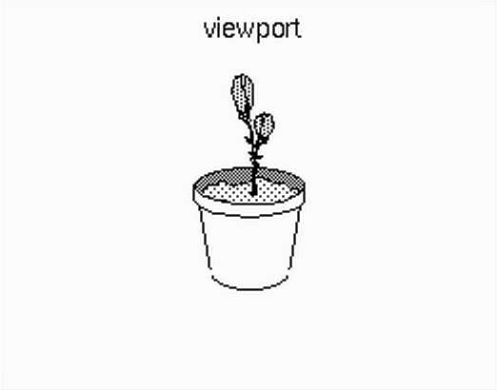
Why 3D transformations (为何要3D变换)?
Rendering a 3D model is similar to the process that we use a camera to take a photo: 3D→2D
真实的照相机
计算机中的虚拟照相机

Slide 22
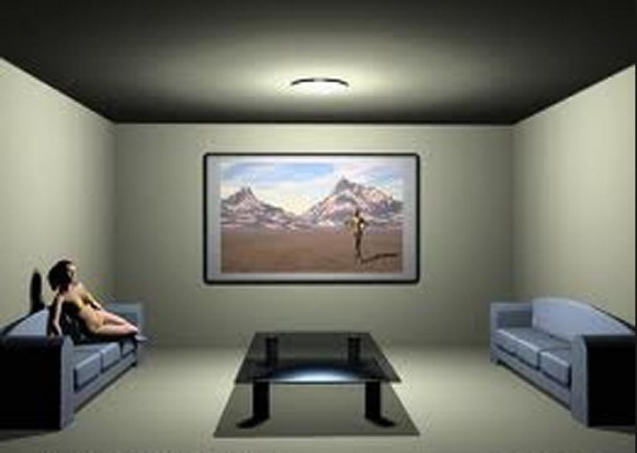

三维变换的基本概念
场景造型
场景坐标系
世界坐标系、局部坐标系
变换：造型变换
放置虚拟照相机
坐标系：视点坐标系
变换：取景变换
Notes:
(虚拟照相机的位置、朝向以及向上的方向)； (在视域四棱锥进行裁剪和背面剔除 )

Slide 23
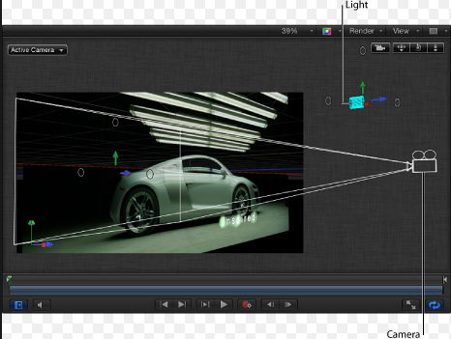
三维变换的基本概念
投影(照相、摄影)：
坐标系：投影坐标系
和窗口坐标系
变换：投影变换
二维显示
坐标系：窗口坐标系、
规格化设备坐标系与
屏幕的物理坐标系
变换：设备变换、视窗变换

Slide 24
坐标变换流程图
局部坐标系
造型变换
world transformation
世界坐标系
取景变换
View transformation
视点坐标系
投影变换
Projection transform.
图像坐标系
设备变换
Device transform.
规格化设备
坐标系
视窗变换
Viewport transform.
屏幕坐标系

Slide 25
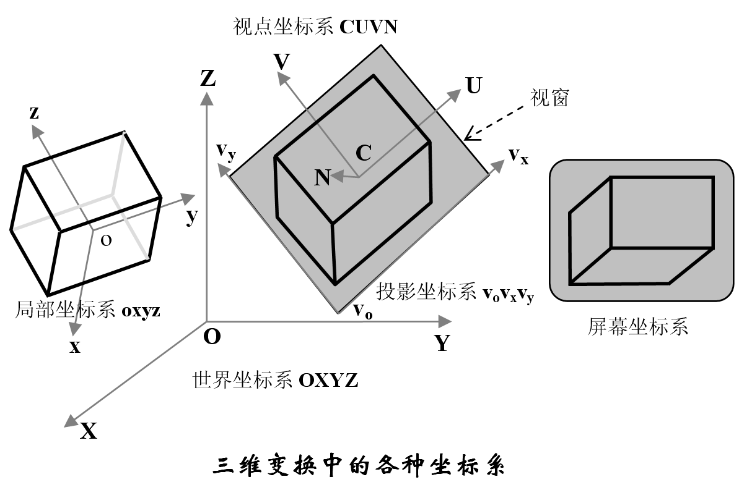
三维变换中的各种坐标系图示

Slide 26

场景坐标系和模型变换
几何场景建立于世界坐标系中
场景中的具体物体与局部坐标系相联系
局部坐标系可以简化物体的定义
物体=｛标准体素，变换｝
造型变换
物体从局部坐标系到世界坐标系的变换
三维线性和非线性变换

Slide 27
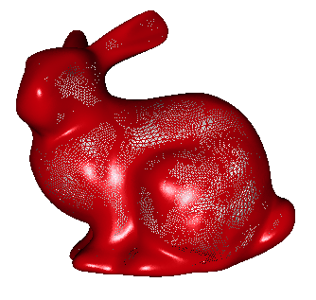
3D Geometric transformation: translation (三维模型变换：平移)
Move P(x,y,z) to P’(x’,y’,z’) by (t_{x},t_{y},t_{z})
P’
T
P

Slide 28
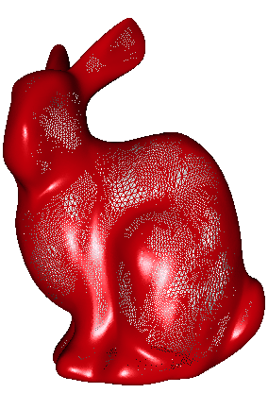
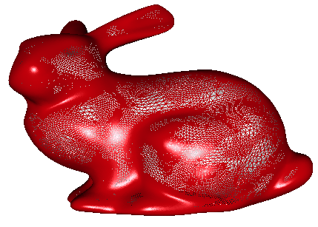
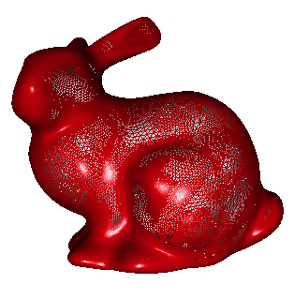
3D Geometric transformation: scale (三维模型变换：缩放)
Scale P(x,y,z) by (s_{x},s_{y},s_{z}) to yield P' (x',y',z')

Slide 29
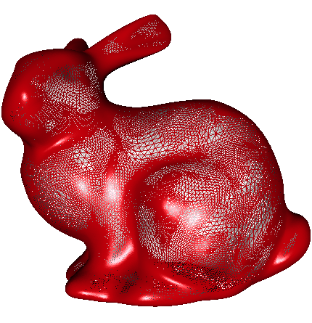
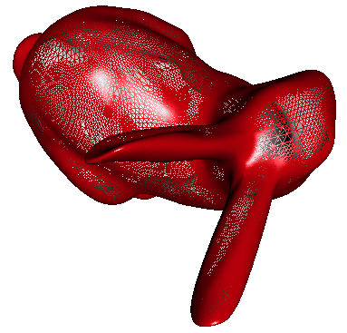
3D rotation transformation
Rotate p with angle θ surrounding x-axis
z
P’
P
y
x

Slide 30
3D rotation transformation
y-axis (θ角)
x
P’
P
z
y

Slide 31
3D rotation transformation
z-axis (θ)
y
P’
P
x
z

Slide 32
Rotation surrounding a general axis (绕一般坐标轴旋转)
Given axis defined by two points(已知旋转轴):
P rotates to P’ by
with respect to the axis
z
Derive the rotation matrix by composition (通过复合方式导出变换矩阵)
P’
P
y
x

Slide 33
Three steps (三步骤)
(1)Transform l such that it overlaps with z-axis
(作变换让l与z轴重合)
(2)Rotate surrounding
z-axis by
(绕z轴旋转)
l
z
z
l
y
y
x
x
(3) Reverse transform.
(逆变换使l回原位)
l
z
y
x

Slide 34
Step 1
(1) Transform l such that it overlaps with z-axis:
can be decomposed three step again
(1a) Translate such that l passes through the origin (平移)
(1b) Rotate surrounding x-axis such that l locate on the ZOX plane (绕x轴旋转)
(1c) Rotate around y-axis such that l locate on the ZOX plane (绕y轴旋转)

Slide 35
(1a) Translation (平移) to origin
z
P’
P
y
x

Slide 36
ii) Rotate by surrounding X-axis(旋转)
角应当是l在YOZ平面
的投影与z轴的夹角。因此：
z
y
x

Slide 37
iii) Rotate by surrounding y-axis (旋转)
这个 角应当是l旋转到ZOX
平面后与Z轴的夹角。因此：
z
y
x

Slide 38
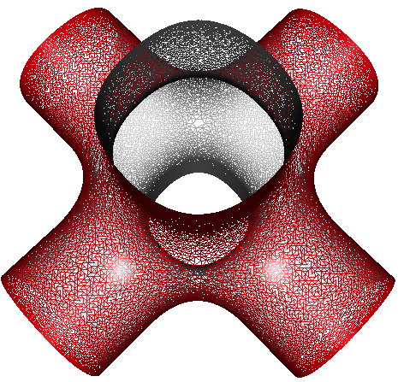
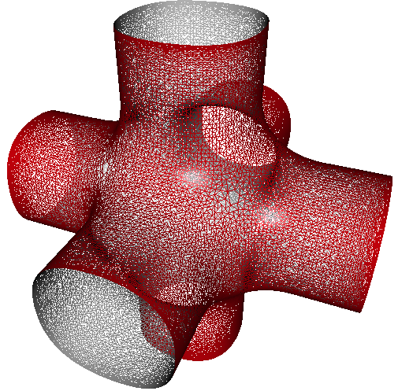
Step 2: Rotate by in terms of z-axis
z
y
x

Slide 39
Step 3: Use reverse transformation to derive final transformation
Why the order of reverse transformations
is contrary to
that of the original transformations?

Slide 40


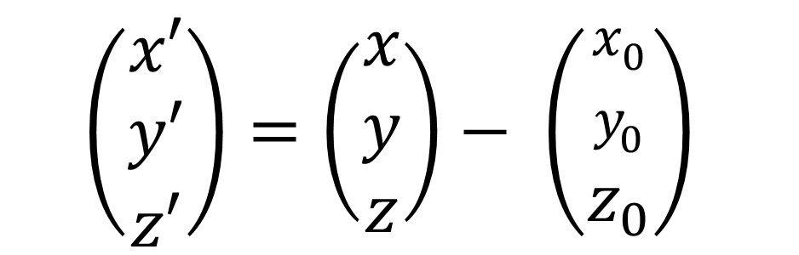
两坐标系之间的变换
平移(X’Y’Z’的原点在($x_{0},y_{0},z_{0})$)
Y’
$$\left(\begin{matrix}x′ \\ y′ \\ z′\end{matrix}\right)=\left(\begin{matrix}x \\ y \\ z\end{matrix}\right)− \left(\begin{matrix}x_{0} \\ y_{0} \\ z_{0}\end{matrix}\right)$$
Y
($x_{0},y_{0},z_{0})$
X’
X
Z’
Z

Slide 41
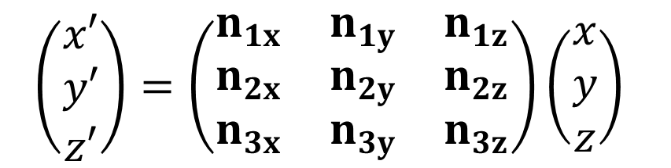
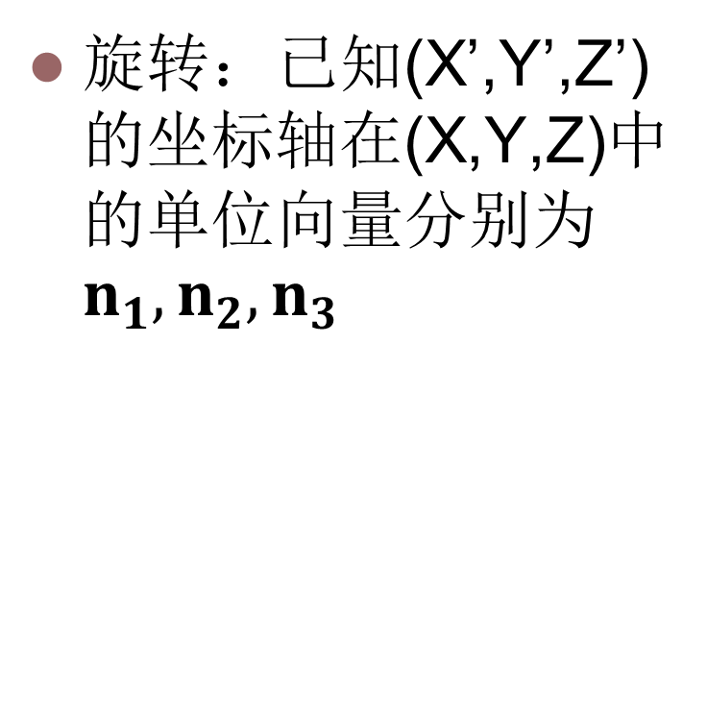
两坐标系之间的变换
Y
旋转：已知(X’,Y’,Z’)的坐标轴在(X,Y,Z)中的单位向量分别为$n_{1},n_{2},n_{3}$
Y’
X
X’
Z
Z’
$$\left(\begin{matrix}x′ \\ y′ \\ z′\end{matrix}\right)=\left(\begin{matrix}n_{1x} & n_{1y} & n_{1z} \\ n_{2x} & n_{2y} & n_{2z} \\ n_{3x} & n_{3y} & n_{3z}\end{matrix}\right)\left(\begin{matrix}x \\ y \\ z\end{matrix}\right)$$

Slide 42
例子：绕任意轴旋转
求绕(1,1,0)—(3,3,2)所在直线旋转90度的变换矩阵
Y
(3,3,2)
X
(1,1,0)
Z

Slide 43
求绕(1,1,0)—(3,3,2)所在直线旋转90度的变换矩阵
平移
Y
(2,2,2)
X
(0,0,0)
Z

Slide 44
求绕(1,1,0)—(3,3,2)所在直线旋转90度的变换矩阵
绕 X轴旋转
Y
(2,2,2)
(0,2,2)
X
(0,0,0)
Z

Slide 45
求绕(1,1,0)—(3,3,2)所在直线旋转90度的变换矩阵
绕 Y轴旋转
(0,2,2)
Y
(2,2,2)
X
(0,0,0)
Z

Slide 46
求绕(1,1,0)—(3,3,2)所在直线旋转90度的变换矩阵
绕 Z轴旋转90度
(0,2,2)
Y
(2,2,2)
X
(0,0,0)
Z

Slide 47

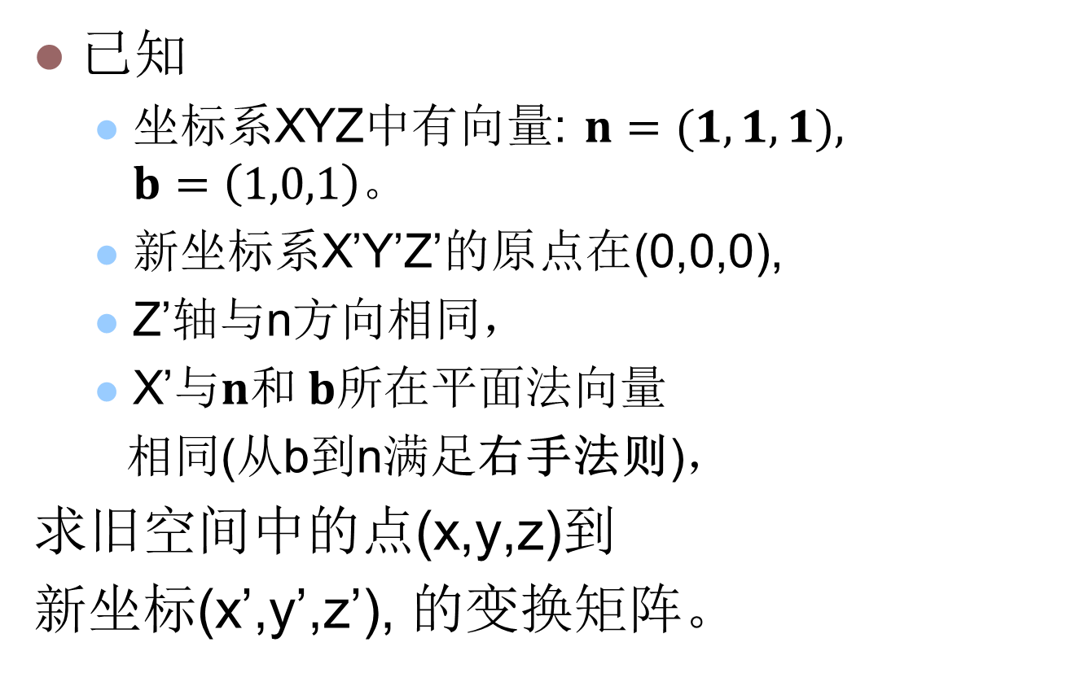

例
已知
坐标系XYZ中有向量: $n=(1,1,1),$ $b=\left(1,0,1\right)。$
新坐标系X’Y’Z’的原点在(0,0,0),
Z’轴与n方向相同，
X’与$n和 b$所在平面法向量
相同(从b到n满足右手法则)，
求旧空间中的点(x,y,z)到
新坐标(x’,y’,z’), 的变换矩阵。
Y
$n=(1,1,1),$
X
$$b=\left(1,0,1\right)$$
Z

Slide 48
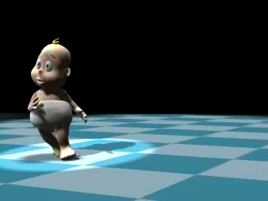
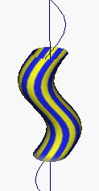
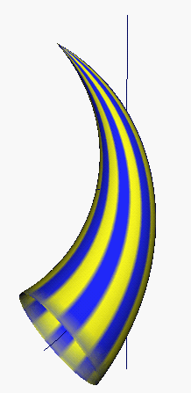
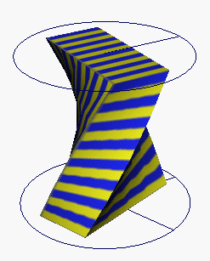
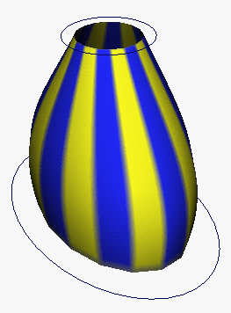
3D modeling tansformations
Nonlinear transformation(非线性三维模型变换)

